Slide 1
Creation and Evolution: Can these two perspectives coexist?
Particularly with regard to the origins of the human being

Slide 2
Prayer
I thank You, my Creator, that You have given me joys in Your creation and ecstasy over the work of Your hands.
I have known the glory of Your works as far as my finite spirit was able to comprehend Your infinity.
If have said anything wholly unworthy of You, or have aspired after my own glory, graciously forgive me.
Johannes Kepler: An Astronomer’s Prayer

Slide 3
Discussion Question:
Can we believe and accept both Genesis 1 and Darwin’s Theory of Evolution? Are these two ideas on conflict with one another?

Slide 4
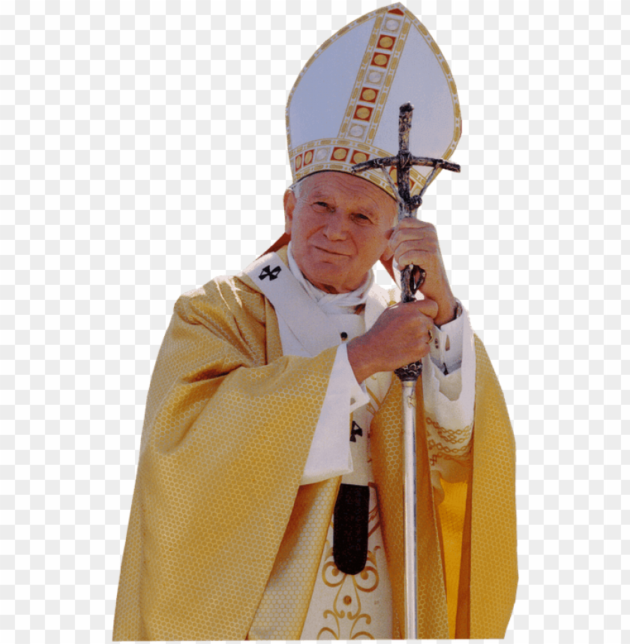
Pope Saint John Paul II says, “yes”
Pope John Paul II in his Message to the Pontifical Academy of Science, On Evolution (1996), explains that evolution is more than a ‘theory’ and is not in direct conflict with the Catholic faith:
"In his encyclical Humani Generis (1950), my predecessor Pius XII has already affirmed that there is no conflict between evolution and the doctrine of the faith regarding man and his vocation, provided that we do not lose sight of certain fixed points.... some new findings lead us toward the recognition of evolution as more than a hypothesis…”

Slide 5
Common misconception that propose that two perspectives can’t “fit” together
A belief that two fields of knowledge (science and theolgoy) cannot overlap.
If humans emerge from a process involving randomness and chance, it is therefore thought that they are not designed or created.
The question of human ensoulment. Some would suggest that if we evolved from primates than humans are merely another animal amongst the rest of the animals and are not distinct in any way.
Ties to a literal interpretation of Genesis, ex. Creationists

Slide 6
What does Darwin’s Theory of Evolution
reveal about the origins of humanity?
In 1859 Charles Darwin published a book titled Origin of the Species. This English naturalist wanted to explain how the various kinds of organisms could have arisen naturally. He described originally there was only one type of living thing which gradually developed(evolved) into many forms of life over millions of years.These forms included bacteria, plants, insects, animals (including mammals). Later in 1871, Darwin wrote another book titled The Descent of Man, he then proposed that humanity itself was the product of the evolutionary processes equally as other life forms. {an example is the Lamarck’s Theory of Evolution opposed to Darwin’s Theory}
Darwin explained further through the concept of natural selection that species would naturally and slowly over time evolve variations in traits that would allow the species to survive their environment more efficiently in their environment. {an example of this is the moth in England during the Industrial Revolution}.
Scientist Niels Stensen {Blessed Nicholas Steno} who made great discoveries in Paleontology, geology, and anatomy showed through sedimentary rock formations that fossils could give a type of timeline that showed evolution of various life forms. Often there is a misunderstanding of the term Theory, considering that these “theories” are not yet proven; however, this is not the case. Scientist do regard Darwin’s theory of evolution as a solidly established theory just as the theory of relativity and the Big Bang Theory.
Notes:
Lamarck: Example with Giraffes who said that traits could develop and change during an animal's lifetime, Darwin believed that individuals were simply born with different traits and that these differences were mostly random that is without order.
Moth example: Due to the Industrial Revolution The White moth became extinct after the black soot produced from local factories made it easier for predators to find white moths, so their species decline. While the black moth was able to hide in the environment; therefore allow their specises to rise in population.

Slide 7
Discussion Question:
Is this explanation enough to describe what it means to be human?

Slide 8
Pope Emeritus Benedict XVI says, “no”
“The doctrine of evolution does not answer everything and does not answer the great philosophical question: Where does everything come from? And how does everything take a path that ultimately leads to the person? It seems to me that it is very important that reason opens up even more, that it sees this information, but that it also sees that this information is not enough to explain all of reality.”
“We are not some casual and meaningless product of evolution. Each of us is the result of a thought of God. Each of us is willed, each of us is loved, each of us is necessary.” - Inaugural Homily in 2004
People often interpret that if we've evolved there must be no meaning or purpose, but this doesn't seem to fit with God knowing us and planning us from all eternity. There must be more to the answer of “what does it mean to be human” than Darwin’s Theory of Evolution can explain.

Slide 9
Knowledge derived from science and
Knowledge derived from theology
Two aspects to consider when examining the world
●HOW does something exist or happen?
●WHY does something exist or happen?
Science can explain the biological process in which humans came to exist in the world, but it is not in the domain of science to propose the purpose of humanity. In other words, science can answer how humans exists, but it cannot answer the question of why humans exist.
Ex.: Music
●HOW it exists: Someone composes/plays/sings a series of notes that create melodies and harmonies to produce a series of sounds.
●WHY it exists: Many reasons! It is an expression of the human experience, it is enjoyable to listen to, it is an expression of poetry and artistry
Science provides the HOW for our existence (the elements, the processes, the laws, etc.) and faith provides the WHY for our existence (the love of God who creates the universe from nothing and sustains it in existence at every moment).
Notes:
Give examples of questions about humanity that science cannot answer. For example, can science explain why you might decide to grow up and study medicine? To determine if your mother loves you, would you conduct a scientific study, or are there other ways you can come to this conclusion? We have different methods of acquiring different types of knowledge.
From both the views of science and religion we can have 2 perspectives that present truths that can coexist, as they satisfy two different types of questions.

Slide 10
Truth cannot contradict truth
These two disciplines give us different persepectives and different details of the same truth.
Science answers how
Theology answers why
Physics, chemistry, and biology cannot explain the soul, because those subjects answer questions about matter. The soul is immaterial and therefore, our knowledge about the soul must come from somewhere other than science.

Slide 11
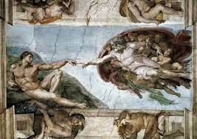
What Genesis 1 reveals about humanity
If we look at genesis strictly historically its hard to overcome. This means that the story is meant to teach us something else. This story isn't trying to tell us a historical story.
Genesis 1 is not meant to give a scientific explanation of the origins of humanity, but rather an understanding why humanity exists and what it means to be human on an ontological level. Genesis 1 is not meant to be read with a literal interpretation as scientific and historical fact, but rather a it is a symbolic story that conveys theological truths.
Necessary truths conveyed from Genesis 1:
Creation is providential
We owe our existence to God
God created man in his image and likeness - with an eternal, spiritual soul
God created out of nothing (ex nihilo)
As we learn more scientifically we learn more about what key truths are there.
Notes:
We owe our existence to God
God intended to create us
There is not an evolutionary process going on filled with chance and then 2000 years ago God
noticed some upright creature running around and thought “I’ll give that thing a soul” - no, God willed it from the beginning.
God could have set into motion the causes that would have ended up evolving into humanity, and at one point in time, God willingly ensouled the first two humans.
Evolution does NOT necesitate meaninglessness, directionless, and purposeless.
God created man in his image
We recognize that man is more than a material being, rather, a unity of body and soul
The science of evolution can’t explain all about facets about man because it can’t explain the immaterial aspect. Science explains the material aspect. Only theolgoy can answer questions about the immaterial soul.
We do know we are physical beings, so science does have a lot to say about what it means to be a human and how we became human, but it does not say everything.

Slide 12
Primary causes and secondary causes
Primary cause -
Secondary cause -
In Christian philosophy and theology, God is the source of existence for all creatures and therefore the Primary cause (always God)
Any real cause within the universe; the kinds of causes studied by scientists (creatures, including all created matter)

Slide 13
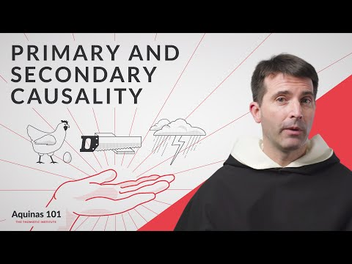
Primary causes and secondary causality
https://www.youtube.com/watch?v=WNZGxWctjzk&list=PL_kd4Kgq4tP8e1BBGrC-eFlp86fqyvGex&index=23

Slide 14
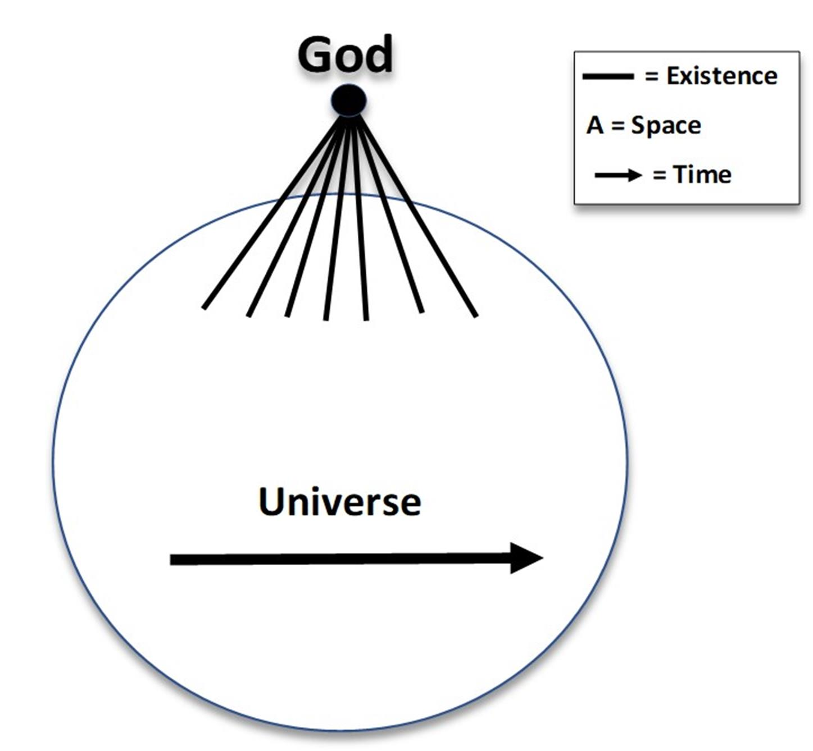
How do primary causes and secondary causes apply to creation?
God is the primary cause of all things in the universe, meaning that at all times God causes all things to be. (primary cause)
God said, “Let there be…”
Therefore, in causing all things to be, God causes them in a way that they are able to be causes of each other in various ways. (secondary causes)
Processes and effects in the universe are caused by things that exist in the universe. God doesn’t intervene each time a change happens; these changes occur because of causes that exist in the natural world.

Slide 15
Chance and Design
Evolution is likely a highly ordered process. There is chance, but chance is secondary.
More importantly, chance does not eliminate the possibility of design.
We live in a highly ordered universe as described by physics. Order is essential for evolution to work. This order influences the outcomes of evolution.
In God’s creation from the process of evolution we can see that freedom and order go hand in hand.
God places within his creation the possibility of collaborating with Him in and through creative work. What we can observe here on earth is God working through His creation.

Slide 16
The Soul
Important distinction: Biological and Theological humans
Biological humans: humans with an anatomical structure
Theological humans: humans which are a composite body and soul, made in the image and likeness of God, with an intellect and will, and are capable of of symbolic and conceptual thought
**Theological humans cannot concretely be identified in fossil records of anatomical structures. Our best way of interpreting at what point theological humans existed in the world is through fossils of sophisticated art.

Slide 17
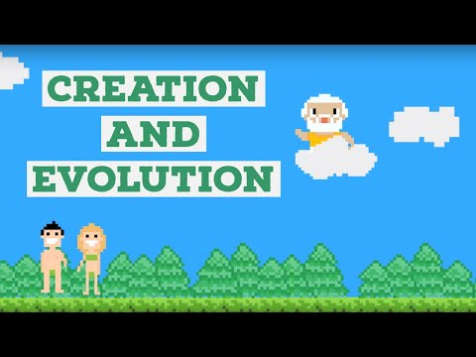
Catholic Central: Creation and Evolution
https://www.youtube.com/watch?v=B_sE07heyy4&t=189s

Slide 18


